Slide 1
VIDCONNECT

Slide 2
TEAM MEMBER
NAME: SHIVAM GUPTA
ROLL NO: 2200290140144
GROUP NO: GB28
PROJECT SUPERVISOR
DR. SHASHANK BHARDWAJ

Slide 3
INTRODUCTION
Introducing VidConnect, a cutting-edge video meeting web application designed to revolutionize the way you connect and collaborate online. With seamless integration and intuitive features, [Application Name] empowers individuals, teams, and organizations to conduct efficient and engaging virtual meetings from anywhere in the world.

Slide 4
TECHNOLOGIE
WEBRTC: WebRTC, or Web Real-Time Communication, is an open-source project that enables real-time communication (RTC) capabilities directly within web browsers and mobile applications. Developed by Google, WebRTC allows peer-to-peer communication for audio, video, and data sharing without the need for additional plugins or third-party software

Slide 5
JAVASCRIPT : JavaScript is a versatile programming language primarily used for web development. It enables dynamic and interactive elements on websites, such as animations, user interfaces, and data manipulation. JavaScript runs in web browsers and increasingly on servers, making it essential for modern web applications and the internet ecosystem

Slide 6
HARDWARE REQUIREMENT
Processor : intel i3 with 8 gb RAM

Slide 7
MODULES
Signaling Module: Signaling is crucial for establishing peer-to-peer connections in WebRTC. This module manages the exchange of session control messages between clients to negotiate and establish communication channels. You can implement signaling using technologies like WebSocket, Socket.IO, or dedicated signaling servers.

Slide 8
Media Stream Module: This module handles the capture and management of audio and video streams from user devices. It might include functionalities for accessing the user's microphone and camera, handling media constraints, and managing stream lifecycles.
Peer Connection Module: Responsible for managing the peer-to-peer connections between clients. It facilitates the establishment of direct data channels for real-time communication, including features like NAT traversal, ICE (Interactive Connectivity Establishment) negotiation, and handling connection states.

Slide 9
User Interface (UI) Module: This module focuses on the presentation layer of your application, providing a user-friendly interface for initiating and managing video calls, accessing chat functionalities, displaying participant information, and controlling media streams.
Network and Security Module: Ensures the security and stability of your WebRTC application. This module might include features like network congestion control, bandwidth management, encryption and authentication mechanisms, and support for secure protocols like HTTPS.

Slide 10
OUTPUTS
Real-Time Audio/Video Communication
Peer-to-Peer Connection
Text Chat Functionality
Media Stream Control

Slide 11
CONCLUSION
In conclusion, the WebRTC web application offers a powerful platform for real-time communication and collaboration over the web. With features such as audio/video calls, text chat, and data sharing, it facilitates seamless interaction between users, making it ideal for remote teams, online education, telehealth, and various other use cases. The application's intuitive UI and robust security measures contribute to a seamless and secure communication experience for users.

Slide 12
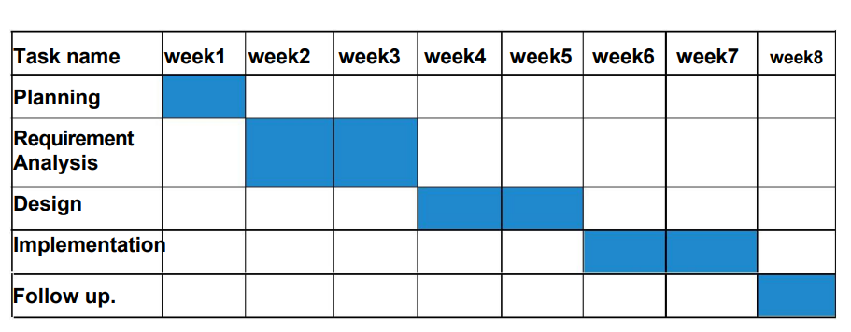
GANTT CHART

Slide 13
THANK YOU

